Slide 1
Energy saving Grand prize to gaina
Eco news by Nissin Sangyo Co., Ltd.
2018 January 22
Edited & translated by N.Iketani

Slide 2
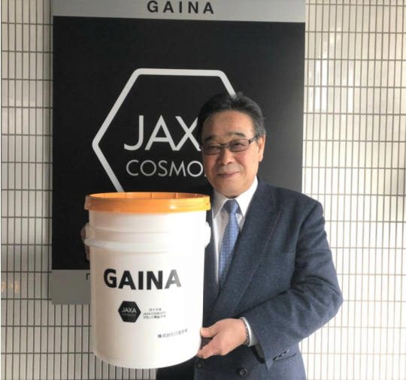
Eco grand prize special award
to Nissin Sangyo Co. Ltd. for GAINA
January 22, 2108
Mr. Tatsujiro Ishiko, president of Nissin Sangyo Co. Ltd was awarded with Eco Grand Prize Special Award by Energy Conservation Center, an organization sponsored by the Ministry of Economy, Trade and Industry.
To GAINA customers
This time, I am very pleased to inform you of such an honor to have received Japan Eco Grand Prize Special Award. The judging committee members of Energy Conservation Center gave us such a wonderful and memorial prize.
We began developing this innovative product, GAINA that can save energy with paint materials, which took 30 years to complete. Following the 43th Iwatani Naoji Memorial Award last year, I received this honor. Establishing conflicting properties of reflection of near infrared ray and radiation of far infrared ray in one coating film as an energy-saving product that can remarkably improve the cooling effect and the heating effect, I received a high evaluation of this award and I won the prize.
To this extraordinary great achievement, I would thank you deeply, and gratefully for the support of distributors, construction shops and users as well as importers and whole-sellers and local dealers.
< Energy saving grand prize stands for the award to the product which produces clearly energy saving effect and excellent performance for the purposed society. i.e., Energy Saving Society. >
Mr. Ishiko, holding a new GAINA’s pale can

Slide 3
エコ大賞受賞
平成30年1月22日
株式会社日進産業
代表取締役 石子 達次郎
省エネ大賞受賞のお知らせ
記
この度、我が社は平成29年度省エネ大賞 審査員会特別賞を受賞いたしました。
塗材で省エネ出来る画期的な商材の開発に着手し、早30年の歳月を要しましたが、
昨年の第43回岩谷直治記念賞に引き続き、栄えある本賞を受賞する事となりました。
近赤外線の反射と遠赤外線の放射という、相反する性質を1つの塗膜の中に確立し、
冷房効果、暖房効果を格段に改善出来る省エネ製品として、高い評価を受け、本賞を
受賞致しました。
この快挙は偏に、販売店様、工事店様、ユーザー様のご支援の賜物と深く感謝致します。
※省エネ大賞とは省エネ社会の構築を目的として、優れた省エネ性能を持つ製品に
授与されるものです。
日本国経済産業省後援の一般財団法人「省エネルギーセンター」が日進産業開発製造製品のガイナに2017年度のエコ大賞特別賞を授与しました。
写真は新らしいガイナを手にする石子社長。

